Slide 1
PAWZ ANIMAL SPA
Fransaita Hazelwood
ACC 202

Slide 2
ABOUT PAWZ ANIMAL SPA
Mission: PAWZ Animal Spa’s mission is to provide excellent animal care in a pet friendly environment while ensuring our customers receive excellent service in a playful atmosphere.
Vision: To be the leading animal care provider with a hands on experience providing individual attention so each animal has the best experience.

Slide 3
Services
Bathing and Drying
Ear Cleaning/ Full body cleaning
Hair Trimming
Hair Cutting and styling
Nail clipping and nail art
Tick and Flea Treatment
Deep Conditioning w/ bathing
Notes:
Provide a brief explanation to the Investors how these services would stand out for my company as compared to other companies which are dealing with animal care.

Slide 4
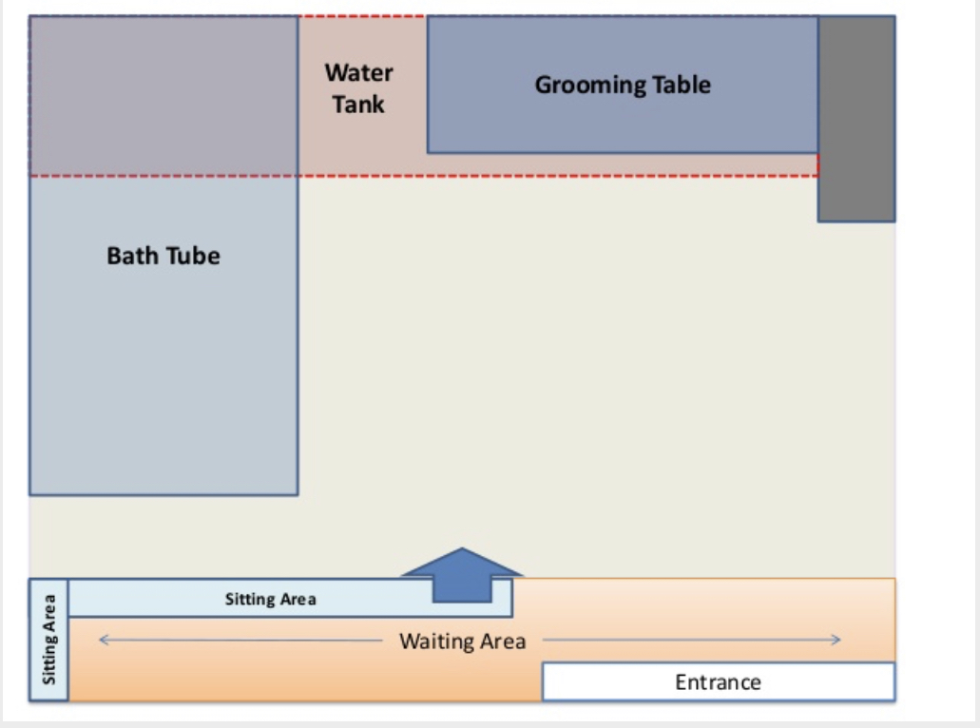
Location and Facility Analysis
PAWZ Animal Spa would be in Midtown Manhattan located in NYC. Which provides clients an easy and accessible location for convenience.
The spa would be about 200-250 square feet.
The rent for our location is estimated to be $386.90 a day based on 12 dogs per day.
The pet population in NYC is 1.1 million. The break down would be 600,000 dogs and 500,000 cats.

Slide 5
Cost Classification
Direct Materials
Direct Labor
Manufacturing Overheads
These costs that are classified are important in the animal daycare business to enable it to be able to meet its mission and vision
Period Costs
Notes:
An example of Direct costs would be Food and Water Bowls and Fencing od Daycare area.
An example of Direct Labor would be pay to the receptionist and Day care attendant
An example of Manufacturing overheads are Costs of kennel and Shampoo
An example of periodic costs is depreciation of the kennels over time.

Slide 6
Variable and Fixed Costs
Grooming: Assuming we have 5 grooms per day, the Variable costs will be $9.97 and fixed costs will be $2,367.92
Daycare: Assuming we will receive 22 dogs per day, one of the major variable cost will be relating to the Day Care attendant which will make an estimated total of $4.65 and fixed costs of $858.44
Boarding: Assuming we board 12 dogs per day, And the kennel attendant will have to work for an estimated variable cost of $7.36 and a fixed cost of $1378.99
Notes:
You need to explain to them the figures are an estimate assuming everything goes well for the daycare business. You can Mention some examples of fixed costs are: Bowls, towel and Kennel attendant.
Some examples of fixed costs are depreciation, Rent, Insurance and maybe a loan (Taken to finance the business operations)

Slide 7
The sales Price per unit of Day Care is an estimate of $ 18.00 for Boarding is $25.00 and Grooming is also $25.00
DAY CARE BOARDING GROOMING
Sales Price $18.00 $25.00 $25.00
Variable Cost per Unit 4.65 7.36 9.97
Contribution Margin $13.35 $17.64 $15.03
Notes:
Contribution margin represents the incremental profit generated for each product/unit sold and is computed as the selling price per unit minus the variable cost per unit. Also known as Profit per unit. The variable cost has been picked from slide 5

Slide 8
DAY CARE BOARDING GROOMING
Sales Price $18.00 $25.00 $25.00
Fixed Costs $858 $1,379 $2,368
Contribution Margin $13.35 $17.64 $15.03
Break- even =Fixed costs/Contribution Margin
Notes:
Break-even analysis is a calculation of the point at which revenues equal expenses
Figures for Fixed costs and Contribution margin have been picked from slides 6 and 7 Respectively.

Slide 9
The Statement of Cost of Goods Manufactured is as follows
 | Amounts
 | $ | $
Beginning Work in Process Inventory |  | 10,000
Direct Materials:
Materials - Beginning
Add: Purchases for month of January | 1,500
Materials Available for Use | 800
Deduct: Ending Materials | (300)
Materials Used in Production |  | (2,000)
Direct Labor |  | (1,400)
Factory Overhead |  | (600)
Total Manufacturing Overhead |  | 6,000
Deduct: Ending Work in Process Inventory |  | -
Cost of Goods Manufactured |  | 6,000
Notes:
Detail to the Investor the details of the various Direct Materials and Labor Overheads. Make it cleat this is just a tentative format subject to change depending on the business prospects and operations.

Slide 10
The following represents the Income statement
PAWZ ANIMAL SPA
Income Statement
For the Month Ended December 31, 2018
 | Revenue:
 | Grooming | 12,000.00
 | Day Care | 10,000.00
 | Boarding | 8,000.00
 | Tota Revenue |  | 30,000.00
 | Cost of Goods Sold * |  | (6,000.00)
 | Gross Profit |  | 24,000.00
 | Expenses:
 | General &Admin Salaries Paid | 1,200.00
 | Advertising | 100.00
 | Cleaning Products | 120.00
 | Depreciation | 83.00
 | Rent | 650.00
 | Loan | 420.00
 | Utilities and Insurance | 600.00
 | Total Expenses |  | 3,173.00
 | Net Income / Loss |  | 20,827.00
Notes:
The grooming, Daycare and Boarding Incomes are just an estimate.

Slide 11
The following represents the Variance Analysis
DATA FOR VARIANCE ANALYSIS:
 | Standard Hours / Qty | Standard Rate | Actual Hours / Qty | Actual Rate
Grooming Labor | 150 | $ 12.00 | 180 | $ 11.50
Grooming Materials | 1,000 | $ 2.00 | 1,200 | $ 3.00
 |  |  | Variance
Groomer Direct Labor Time Variance
(Actual Hours - Standard Hours) x Standard Rate | (180-150)*12 |  | 360
Groomer Direct Labor Rate Variance
(Actual Rate - Standard Rate) x Actual Hours | (11.50-12.00)*180 |  | -90
Direct Materials Quantity/Efficiency Variance
(Actual Quantity - Standard Quantity) x Standard Price | (1200-1000)*2 |  | 400
Direct Materials Price Variance
(Actual Price - Standard Price) x Actual Quantity | (3-2)*1200 |  | 1200
Notes:
The Variance analysis has been calculated based on the Data given for Grooming Labor and Grooming Materials

